Slide 1
ABAP Part II
Lesson 06: SmartForms

Slide 2
Lesson Objectives
After completing this lesson, participants will be able to -
Know the Smartforms Architecture
Work with SAP Form Builder
Work with Texts, Addresses and Graphics
Work with Data in Forms
Work with Tables and Templates
Flow Control
Integrate SmartForms into Application Programs
Work with Fonts and Bar Codes

Slide 3
Smart Forms-Introduction
Tool to create and maintain forms with minimal programming effort
Easy to create the form without much programming knowledge
Allows to execute simple modifications to the form and in the form logic by using graphical tools

Slide 4
Basic Features of SMARTFORM
Data retrieval and form logic are separated from each other.
Application program passes data to Smartform through Function module interface which is generated automatically on Smartform activation.
Reduces the implementation cost.

Slide 5
Key Benefits of SMARTFORM
Less Programming Efforts
Output of background graphics, for form design
Colored output of texts
User-friendly and integrated Form Painter for the graphical design of forms.
Graphical Table Painter for drawing tables

Slide 6
SMARTFORM Architecture
SmartForm
WEB Browser
ABAP Function Module(Generated)
Application Program
Printer
Fax
Database
Data Retrieval
Form Logic
Output Device

Slide 7
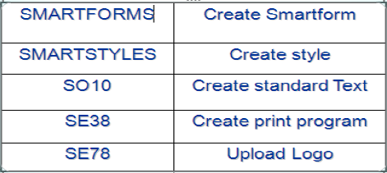
Smartform Architecture - Structure
A Smart form has the following attributes:
1.Layout: A layout. In the layout, you define how the output data is positioned, its appearance in graphics, and the design of the pages.
2.Form logic : control the flow of the form output.
3.Form interface to transfer application data to the form definition.
Transactions

Slide 8
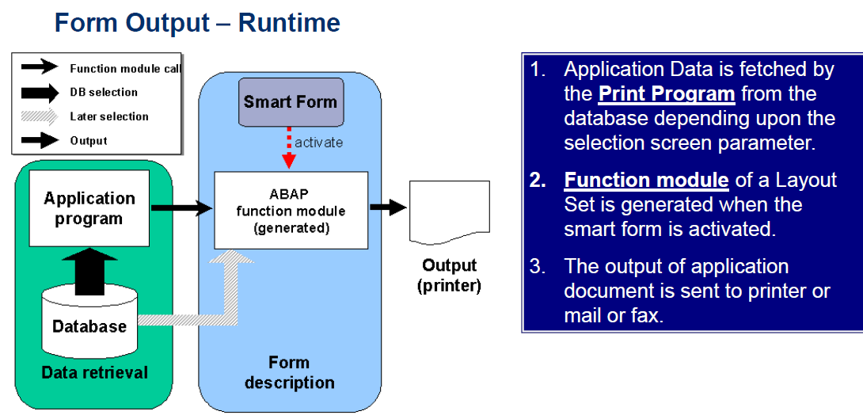
Architecture - Form Output Runtime
The following graphics show you the architecture that is implemented when you create and print a Smart form.

Slide 9
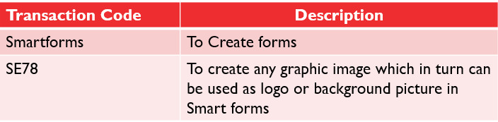
Transaction Codes in Smart Forms
Different Transaction codes used while working with Smartforms are

Slide 10
Structure of SmartForm
SMARTFORMS provides a graphical user interface which is divided into three different parts:
Navigation Panel
PC Editor
Form Painter

Slide 11
Demo: View Smartform Interface

Slide 12
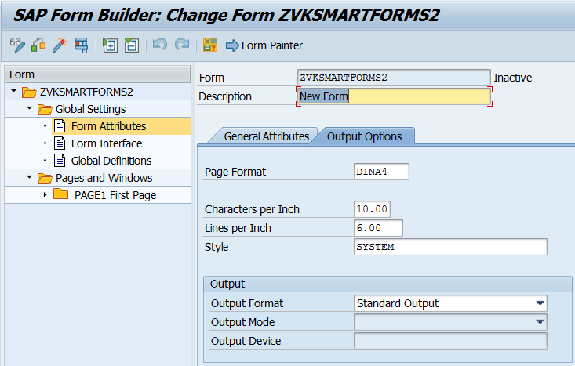
Smart Forms - Navigation Panel
Global Settings Has 3 sections
Form Attributes
Define settings necessary for printing like page format, characters per inch, flag for XSF output etc

Slide 13
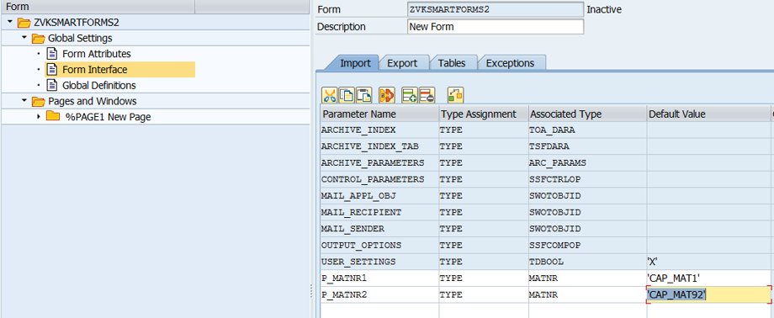
Navigation Panel - Global Settings
Form Interface
To transfer application data to form definition
The IMPORT EXPORT parameters and INTERNAL TABLES are declared
Exception handling is also taken care.

Slide 14
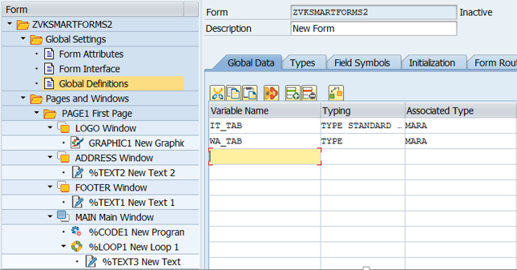
Navigation Panel - Global Settings (Contd.).
Global Definition
Allows user to declare variables which can be used on global scope
Specify the Data Objects used in Form

Slide 15
Pages and Windows
Provides list of all components of form
All the basic elements are maintained under this node
Pages
Windows
Graphic
Address

Slide 16
Pages
Each form consists of one or more pages
The first page in the tree structure is the start page
The page layout includes the page format and the position of windows on a page

Slide 17
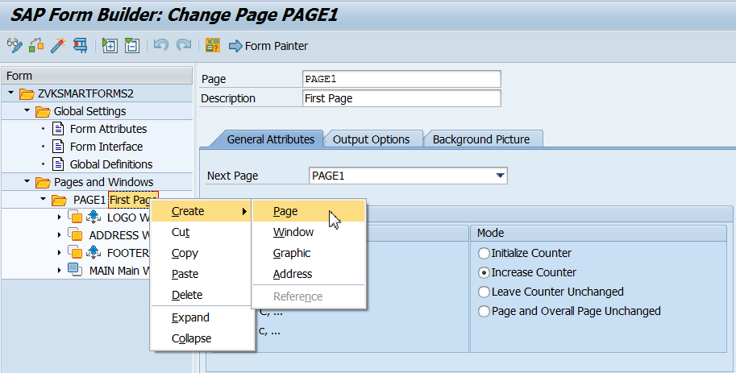
Procedure for Creating Page
Select an existing page node to position the new page node
Create a new page node in the navigation tree of the Form Builder
Name and description has to be specified
The format and mode of the page counter has to be specified on General Attributes tab

Slide 18
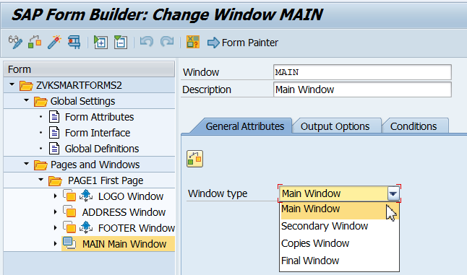
Windows
Output areas for all output data
Size and position are set in the Form Painter
Following are the Window Types in Smartforms
Main window
Secondary window
Copies Window
Final Window

Slide 19
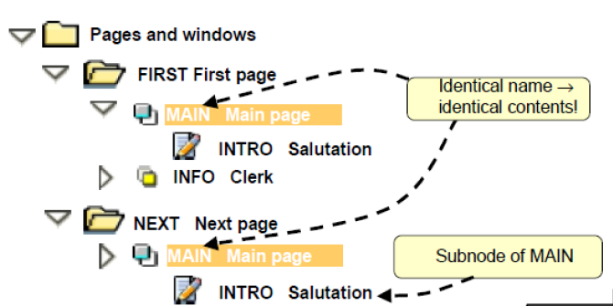
Form Builder - Structuring Pages

Slide 20
Main Window
Display the text and data that runs in to several pages
It automatically triggers the page break
Only one window in a form is main window
The main window must have the same width on each page
A page without main window must not call itself as next page, since this would trigger an endless loop

Slide 21
Secondary-Windows
Text and data displayed in a predetermined output area.
Text and data that do not fit into the secondary window are truncated and not displayed.

Slide 22
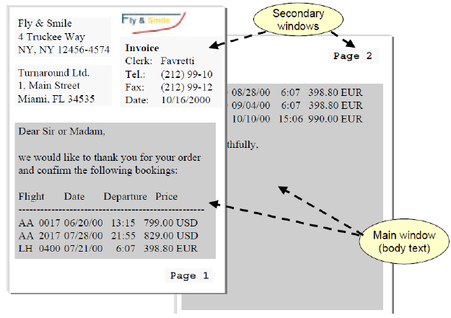
Form Builder - Main and Secondary Windows
Notes:
1.You can only define one window in the form as the main window.
2.The main window must have the same width on each page. You can choose the height and position as required.
3.A page without a main window may not refer to itself as the next page since this would cause an endless loop. In this case, the system terminates after processing three pages

Slide 23
Copies-Window
The content will appear either in the copy form or original form
This is used for printing the copies of the form

Slide 24
Final-Window
Final window is used to display values which are processed in the initial pages

Slide 25
Texts and Data in a Form:
Texts and data are entered using PC Editor
Various Operations performed in the PC Editor
Tables or templates can be used to display texts and data in table format

Slide 26
Positioning of Texts on the Form
All the texts in the form are displayed using text nodes
The only exception is addresses, which are displayed using their own node

Slide 27
Entering Texts in PC Editor
New texts are entered in PC Editor
The system fields and the user-defined fields are used to include data from form interface
These fields are replaced with values when the form is processed

Slide 28
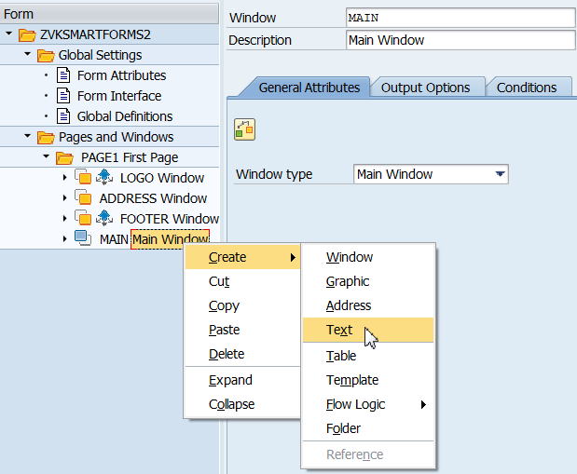
Creating Text
Procedure
1. Create a text node in the navigation tree of the Form Builder.

Slide 29
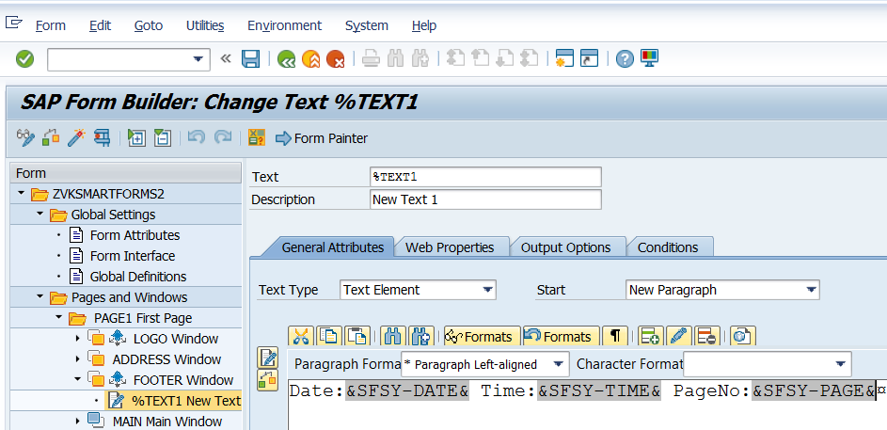
Text Element in Form
Enter a unique name for the node and a node description.
On the General Attributes tab choose Text Element as text.

Slide 30
Demo: Create a smartform without table

Slide 31
Integrating the Smart Form into the Application
Form printing triggered by calling function modules
Name of the form determines the name of the generated function module.
The name of the generated function module is unique only within one system.

Slide 32
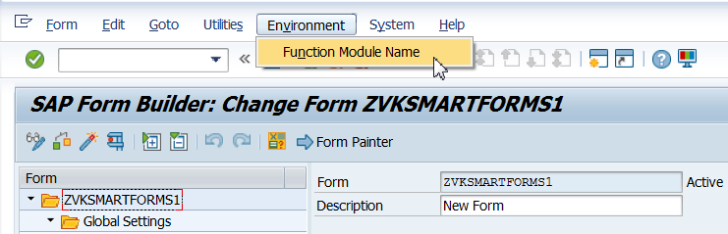
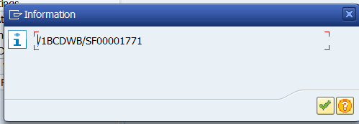
Procedure
In the Form Builder call the function Environment →Name of the function module and copy its name.
Choose this menu to get the Function Module name
The smart form function module name

Slide 33
Procedure (Contd.).
In the application program define a variable of type RS38L_FNAM for the name of the generated function module:
Data fm_name type RS38L_FNAM.
The Smart Form can be called in other parts of the application program as well.
Function module SSF_FIELD_LIST - to list form parameters
Function module SSF_FUNCTION_MODULE_NAME - returns the name of generated function module

Slide 34
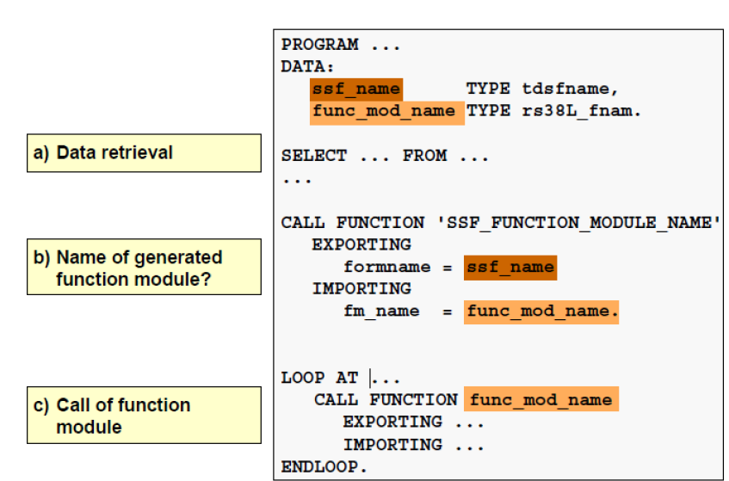
Integration in ABAP programs

Slide 35
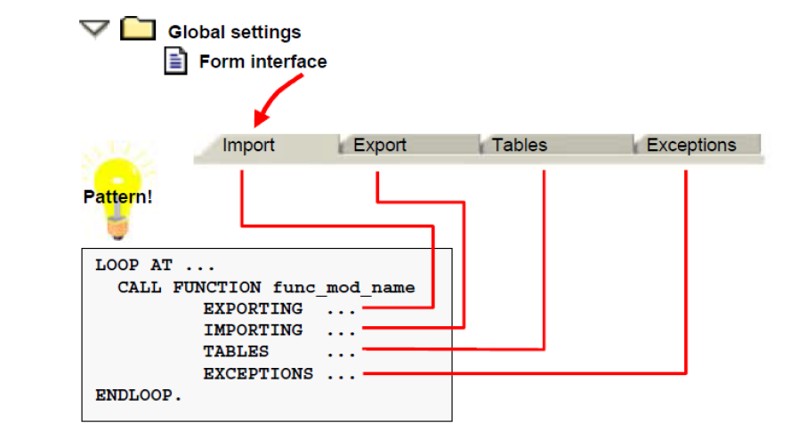
Integration into Application Programs – Generated Function Module
Notes:
1.Each generated function module has the interface that you defined on the four tabs of the global settings for the SAP Form Builder.
2.Replace the name after CALL FUNCTION with the variable that is filled by calling SSF_FUNCTION_MODULE_NAME and contains the current name of the generated function module at runtime.

Slide 36
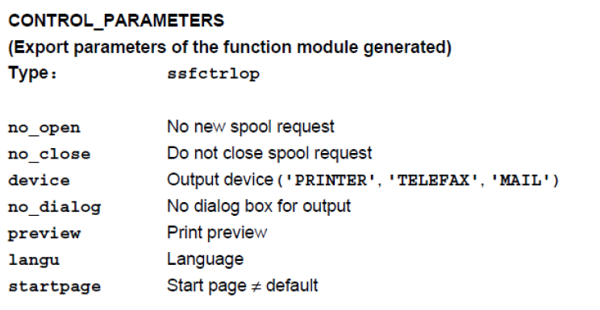
Integration into Application Programs – Control Structure CONTROL_PARAMETERS

Slide 37
Demo: Integrate smartform in application

Slide 38
Text Modules
Text modules are used to centrally store texts that are used frequently in forms in the system.
Text modules are included in forms using texts nodes
Allows easy use of text from a text module in several forms
It Can be used across clients

Slide 39
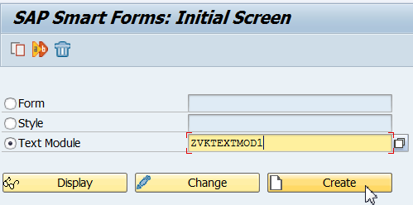
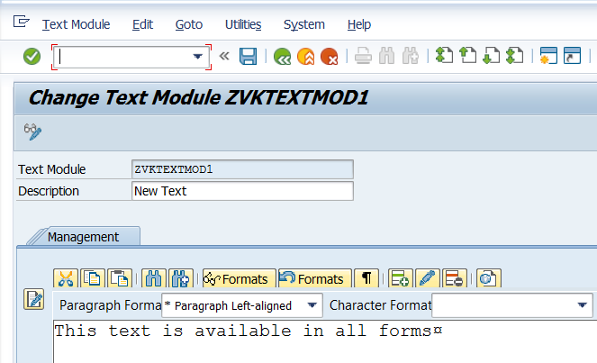
Creating Text Module (Contd.).
Text module name

Slide 40
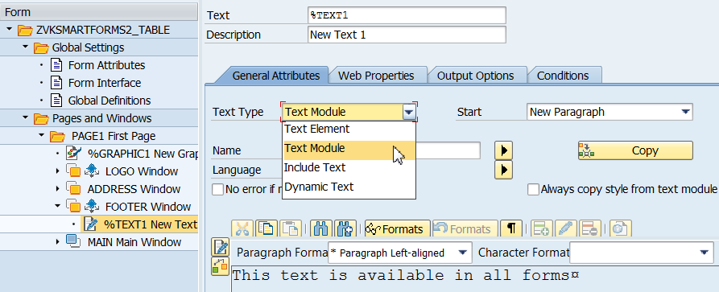
Include Text Module in Form
1. Create a text node in the navigation tree
2. In General attributes tab change the type as ‘TEXT MODULE’
3. Change text name to the name of the text module
Choose to insert the text created

Slide 41
Demo: Create and include text module in a form

Slide 42
Inserting Addresses:
Administered using the Business Address Services (BAS)
According to the postal regulations of the sender country, the address is formatted
Three address types
Company addresses(address type 1)
Personal addresses(address type 2)
Workplace addresses(address type 3)

Slide 43
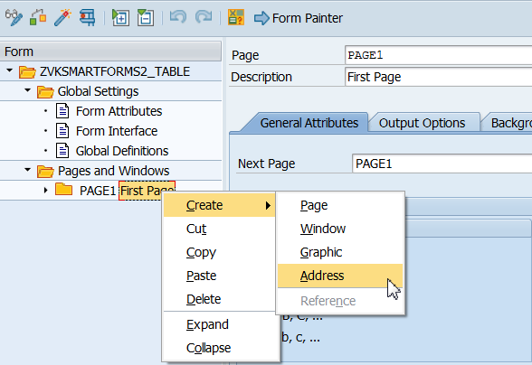
Creating Address-type

Slide 44
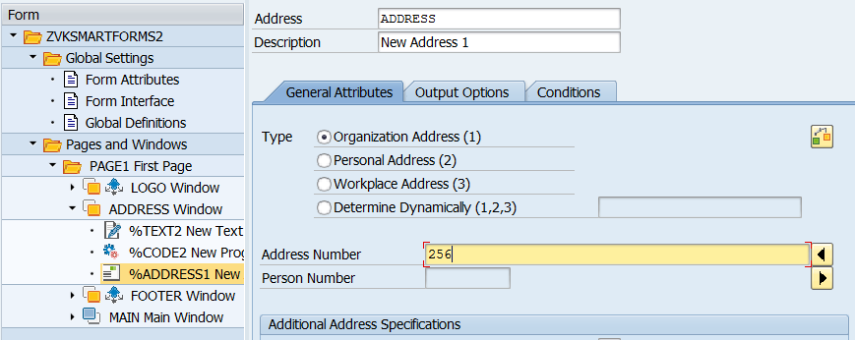
Address:

Slide 45
Graphics In Smartforms
To import, administer and transport images or graphics
They can be incorporated statically into a form or include them dynamically using an appropriate field
Images can be included in background as well

Slide 46
Demo: Create Address

Slide 47
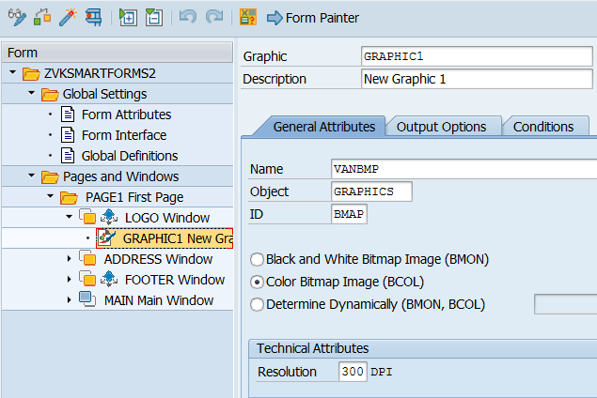
Graphics
*.BMP and *.TIF files can be imported and used in forms.
SE78 - Graphic administration.

Slide 48
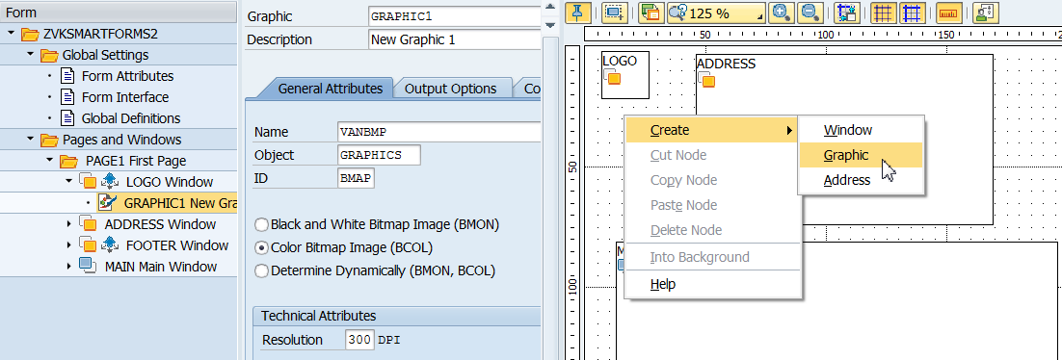
Creating Graphics in Smart Forms
Create window to add Images

Slide 49
Demo: Create Graphics in Smartforms

Slide 50
Working with Tables
To display or print contents in tabular form
Node types
Template node
Static - The number of columns and lines are determined before the actual output
Table node
Dynamic - Table size depends on the amount of data selected at runtime
Line Types Specifies
Width of table line
The layout of both node types
Also the width of the individual cells within the table line
Notes:
1.Since the length of tables is dynamic, you should only use them in main windows since they may be truncated in secondary windows.
2.You can format the individual line types in the graphical Table Painter

Slide 51
Printing tables
The table can be designed independent of the number of lines
The size of the table depends on how much data the application program passes to the form at runtime
Tables cannot be nested.
Output of a table can be divided into
header
main area
footer

Slide 52
Accessing Application Data
The application program reads the data to be displayed on the form as a table from the database and writes it into an internal table
When calling the Smart Form, this internal table is passed to the form interface to access it within the form description
Access the internal table to display it on the form line by line
To accessing several internal table for table output whose entries are interdependent combine loop and table nodes

Slide 53
Reading Internal-Tables
The table is printed in the form line by line as the number of selected entries in the internal table differs
The table node defines a table layout
The Data tab is used to access internal tables, which exists for loop nodes and for table nodes

Slide 54
Procedure to read Internal Tables
Create a work area for the internal table in the global definitions
Go to Data tab of the loop or table node and mark Internal Table else the loop is deactivated
Enter the name of the internal table that is passed at the form interface
Enter the assignment type (INTO or ASSIGNING) and a work area (structure with the same type as the table line or the field symbol)
If a table with header line is used as work area specify the internal table name again
If desired, use the input fields Line and To to limit the lines of the internal table that is to be read
Use the group box WHERE Condition to select a particular part of the data in the internal table

Slide 55
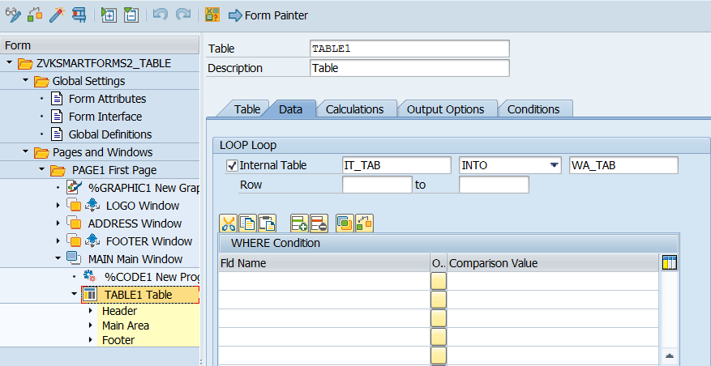
Procedure
Specify the Data source for tables

Slide 56
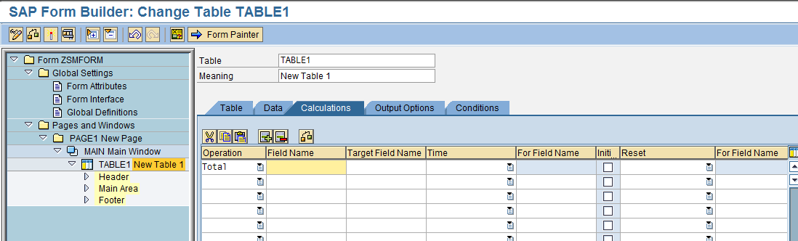
Table Calculations - Procedure

Slide 57
Demo: Create table in smartform

Slide 58
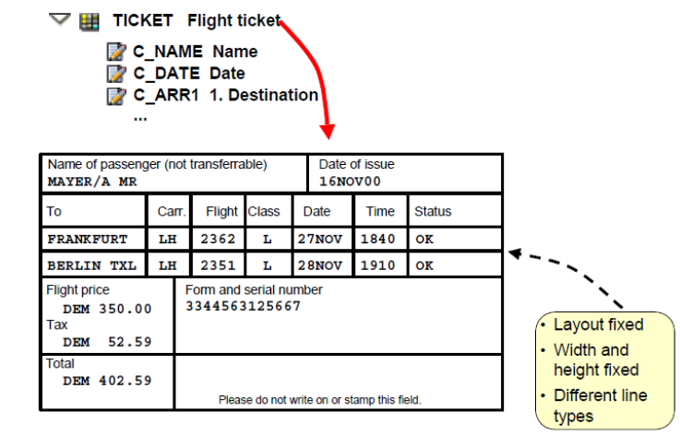
Template
1.You use the Template node type to output tables with a fixed layout and size.
2.Templates cannot be nested
Notes:
The width of the template must not exceed the width of the window into which the template is embedded

Slide 59
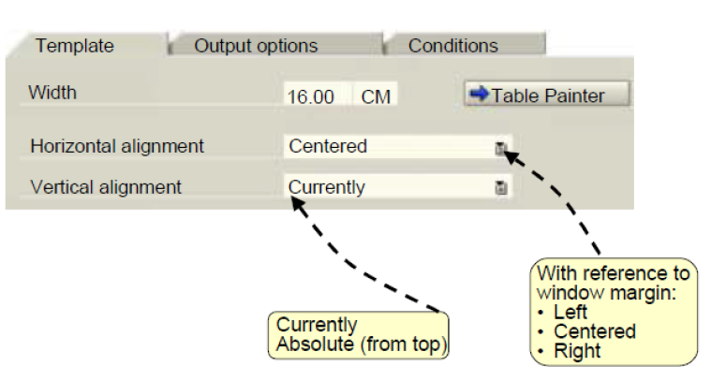
Template Layout

Slide 60
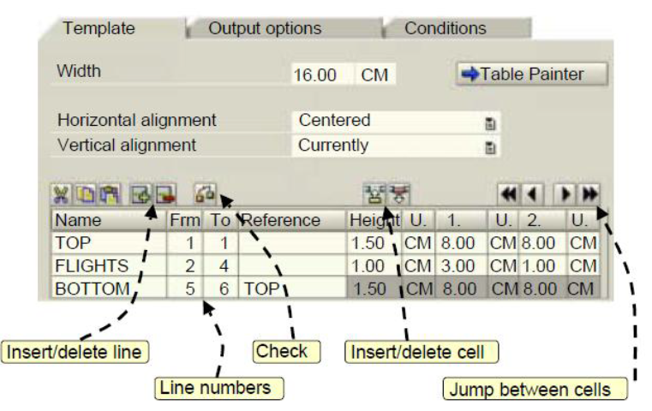
Template Layout

Slide 61
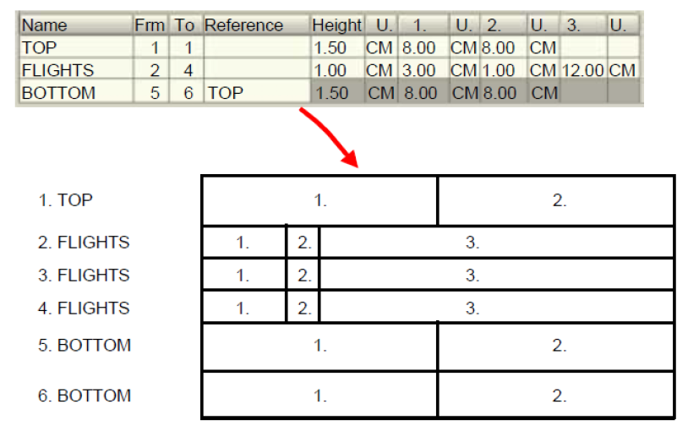
Template Layout

Slide 62
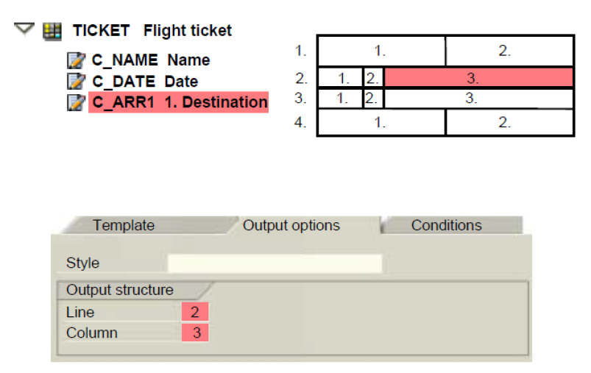
Template Layout

Slide 63
Demo: Create template in smartform

Slide 64
Dynamic Page-Break
Page break triggered when the main window of a page is full
Only the contents of main window can spread over several pages

Slide 65
Page-Numbering
&SFSY-PAGE&
Specifies current page number
&SFSY-FORMPAGES&
Specifies total number of pages in the form
&SFSY-JOBPAGE&
Specifies total number of pages in all forms in the print job

Slide 66
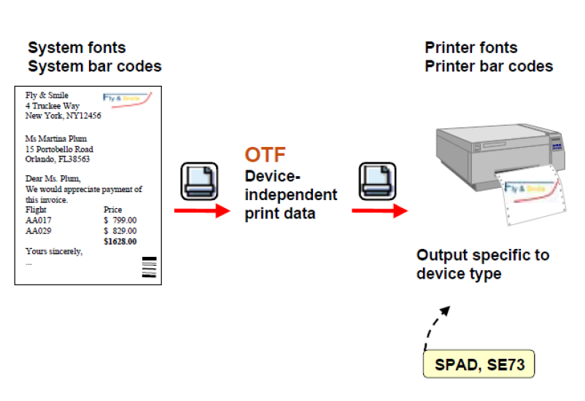
Font and Bar Code Maintenance

Slide 67
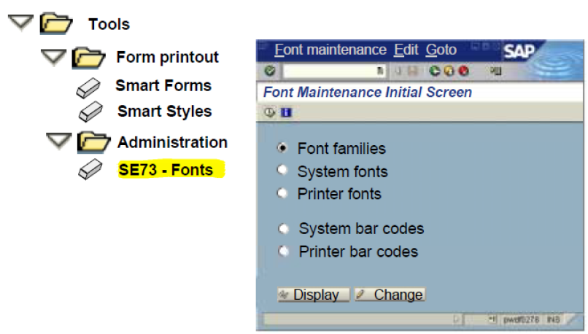
Accessing Font Maintenance

Slide 68
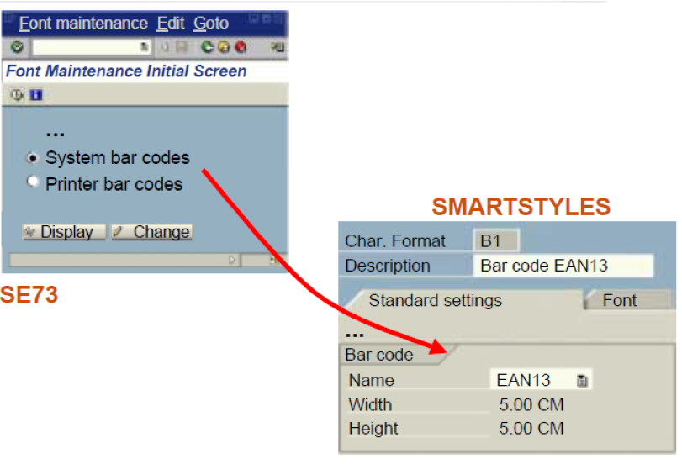
Maintaining and Using Bar Codes

Slide 69
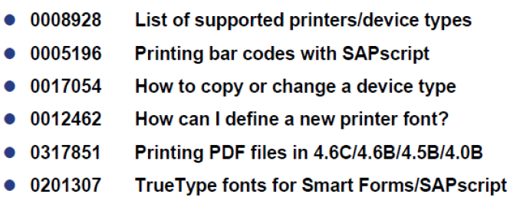
OSS Notes for Fonts and Bar Codes

Slide 70
Summary
In this lesson, you have learnt:
The Smartforms Architecture
SAP Form Builder
Texts, Addresses and Graphics
Tables and Templates
Flow Control
How to Integrate SmartForms into Application Programs
Fonts and Bar Codes

Slide 71
Review Question
Question 1._____ is used to transfer application data to the form definition.
Question 2: Text modules are included in forms using _____.

